Slide 1
CM1606: Computational Mathematics
Data Analysis
Week 01 | by Prashan Rathnayaka (prashan.r@iit.ac.lk)

Slide 2
Learning Outcomes
On completion of this lecture, students are expected to be able to:
demonstrate some knowledge associated with statistics related to data analysis
use R for basic statistical calculations

Slide 3
Exploratory Data Analysis (EDA)
The first step in any data science project is the exploration of data. With his famous book “Exploratory Data Analysis (EDA)” in 1977, Tukey proposed a new discipline in statistics called "data analysis” Which included ‘statistical inference’ as just one component.
On the other hand, "probability theory", the mathematical foundation for statistics, was developed long before data analysis (17th-19th centuries by Bayes, Laplace, and Gauss; and further by Russian mathematicians like Kolmogorov, Markov, and Chebyshev)
Key drivers of EDA are rapid growth in new technology, access to big data, and greater use of quantitative analysis in many fields.

Slide 4
Data Sources
Data Sources
Today’s data are not just numbers.
They include measurements, events, text, images, and videos.
Much of this data are unstructured (or unsummarized).
The challenge of data science is to convert the unstructured data into meaningful and actionable information (called ‘value added’ data).

Slide 5
Data Types
Data
Numerical
Continuous
Discrete
Categorical
Binary
Ordinal
5

Slide 6
Data Types
Continuous (interval, float, numeric)
Data that can take on any value in an interval.
Ex: speed, volume, length, time, weight, height, etc.
Discrete (integer, count)
Data that can take on only integer values, such as counts.
Ex: number of accidents per hour, number of insects per unit area, number of defects per item, etc.
5

Slide 7
Data Types
Categorical (Enums, enumerated, factors, nominal, polychotomous)
Data that can take on only a specific set of values representing a
set of possible categories.
Ex: Gender (M, F), Size (Small, Medium, Large), Religion (Buddhism,
Christianity, Hinduism, Islam), etc.
Binary (dichotomous, logical, indicator, Boolean)
A special case of categorical data with just two categories of values (0/1, true/false).
Ex: yes/no, success/failure, 1/0, male/female, etc.
5

Slide 8
Data Types
Ordinal (Ordered factor)
Categorical data that has an explicit ordering.
Ex: score: (0, 1, 2, 3, 4), qualification: (O/L, A/L, B.Sc., M.Sc., Ph.D.)
Note that: Knowing the data type is important for data analysis and prediction
5

Slide 9
Rectangular Data(spreadsheet, database,data matrix)
The typical frame of reference for analysis in data science is a rectangular data object, like a spreadsheet or database table.
Data frame: Rectangular data (like a spreadsheet) is the basic data structure for statistical and machine learning models.
Feature: A column in the table is commonly referred to as a feature.
Outcome: Many data science projects involve predicting an outcome
Records: A row in the table is commonly referred to as a record.

Slide 10
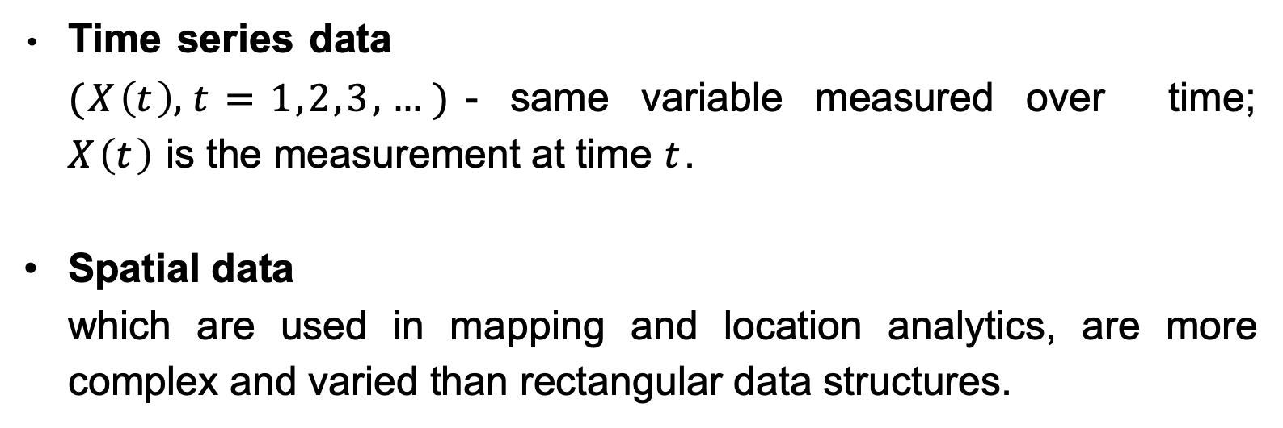
Non-rectangular data structures
Time series data
$(X\left(t\right), t=1,2,3,…)$- same variable measured over time; $X\left(t\right)$is the measurement at time $t$.
Spatial data
which are used in mapping and location analytics, are more complex and varied than rectangular data structures.

Slide 11
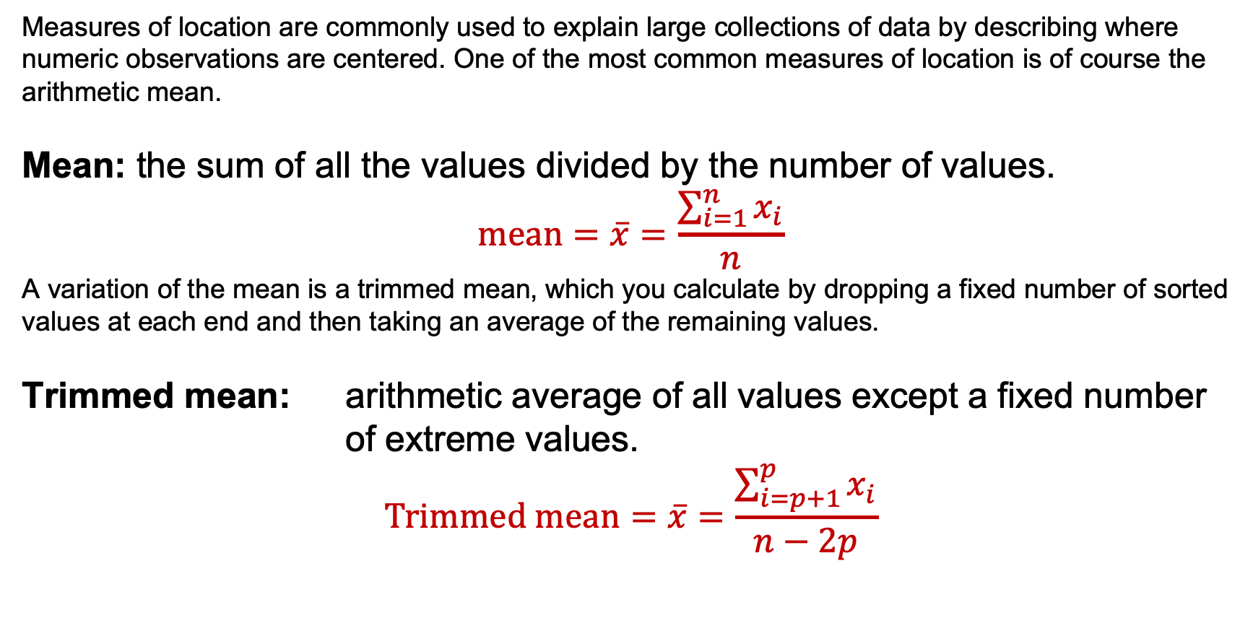
Measures of Location (= center)
Measures of location are commonly used to explain large collections of data by describing where numeric observations are centered. One of the most common measures of location is of course the arithmetic mean.
Mean: the sum of all the values divided by the number of values.
$$mean=\overline{x}=\frac{\sum_{i=1}^{n}{x_{i}}}{n}$$
A variation of the mean is a trimmed mean, which you calculate by dropping a fixed number of sorted values at each end and then taking an average of the remaining values.
Trimmed mean: arithmetic average of all values except a fixed number of extreme values.
$$Trimmed mean=\overline{x}=\frac{\sum_{i=p+1}^{p}{x_{i}}}{n−2p}$$

Slide 12
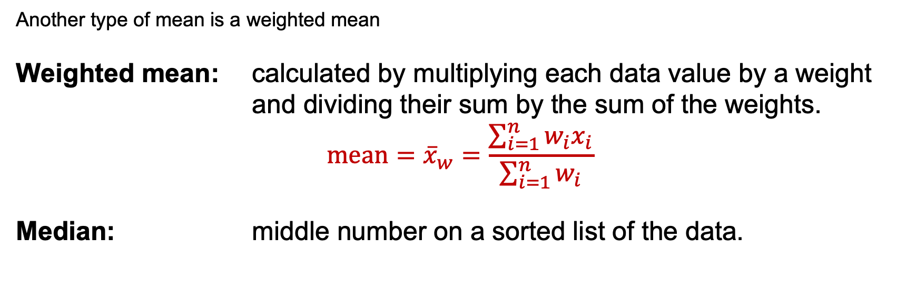
Measures of Location (= center)
Another type of mean is a weighted mean
Weighted mean: calculated by multiplying each data value by a weight and dividing their sum by the sum of the weights.
$$mean={\overline{x}}_{w}=\frac{\sum_{i=1}^{n}{{w_{i}x}_{i}}}{\sum_{i=1}^{n}{w_{i}}}$$
Median: middle number on a sorted list of the data.
Note: Mean is a good measure of the canter if extreme values are not present in the dataset. The Median is not affected by extreme values.

Slide 13
Measures of Location (= center)
Mode: most frequently occurred value
Robust measures: not sensitive to extreme values
Outliers: values that seem very different from others.
outliers may not be invalid data values! Must handle with care.

Slide 14
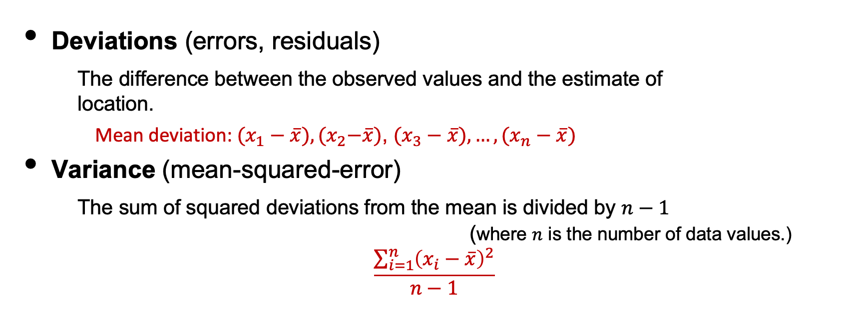
Measures of Variability (=dispersion, spread)
Location is just one dimension in summarizing a feature. A second dimension, variability, also referred to as dispersion, measures whether the data values are tightly clustered or spread out. At the heart of statistics lies variability
Deviations (errors, residuals)
The difference between the observed values and the estimate of location.
Mean deviation: $(x_{1}−\overline{x}),{(x}_{2}−\overline{x})$, $(x_{3}−\overline{x}),…,(x_{n}−\overline{x})$
Variance (mean-squared-error)
The sum of squared deviations from the mean is divided by $n−1$ (where $n$ is the number of data values.)
$$\frac{\sum_{i=1}^{n}{{\left(x_{i}−\overline{x}\right)}^{2}}}{n−1}$$

Slide 15
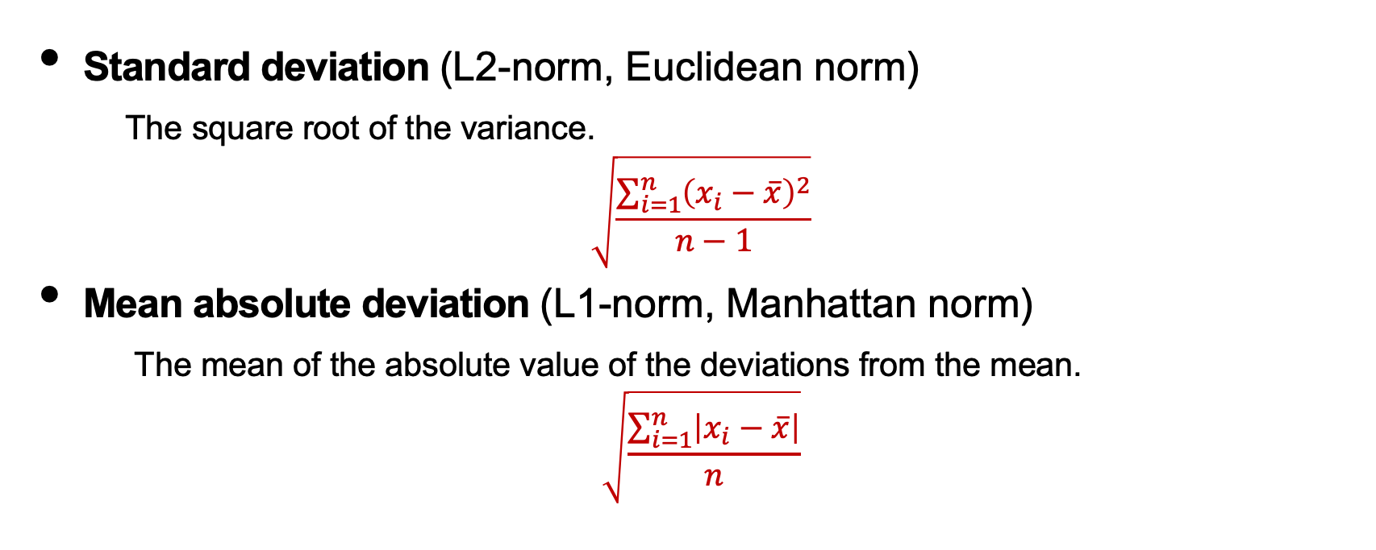
Measures of Variability (=dispersion, spread)
Standard deviation (L2-norm, Euclidean norm)
The square root of the variance.
$$\sqrt{\frac{\sum_{i=1}^{n}{{\left(x_{i}−\overline{x}\right)}^{2}}}{n−1}}$$
Mean absolute deviation (L1-norm, Manhattan norm)
The mean of the absolute value of the deviations from the mean.
$$\sqrt{\frac{\sum_{i=1}^{n}{\left|x_{i}−\overline{x}\right|}}{n}}$$

Slide 16
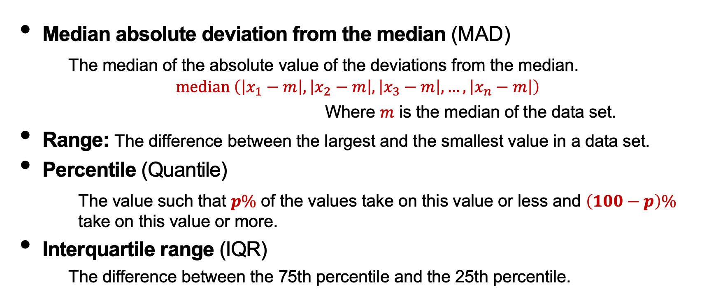
Measures of Variability (=dispersion, spread)
Median absolute deviation from the median (MAD)
The median of the absolute value of the deviations from the median.
$$median \left(\left|x_{1}−m\right|,\left|x_{2}−m\right|,\left|x_{3}−m\right|,…,\left|x_{n}−m\right|\right)$$
Where $m$ is the median of the data set.
Range: The difference between the largest and the smallest value in a data set.
Percentile (Quantile)
The value such that $p\%$ of the values take on this value or less and $\left(100−p\right)\%$ take on this value or more.
Interquartile range (IQR)
The difference between the 75th percentile and the 25th percentile.

